Slide 1
Web Design Mistakes
Olivia Kriley

Slide 2
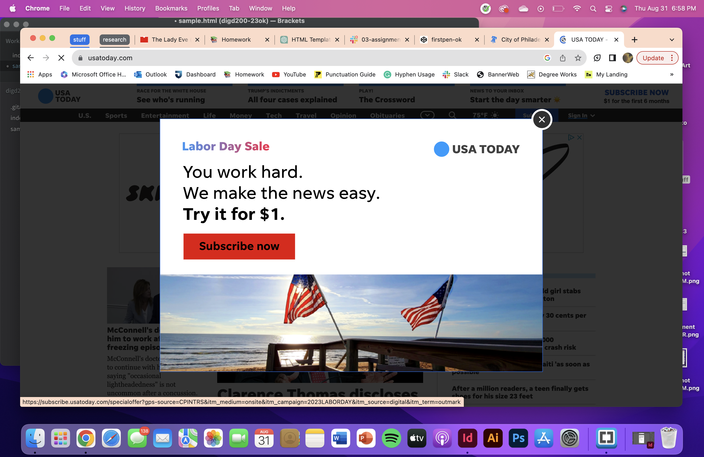
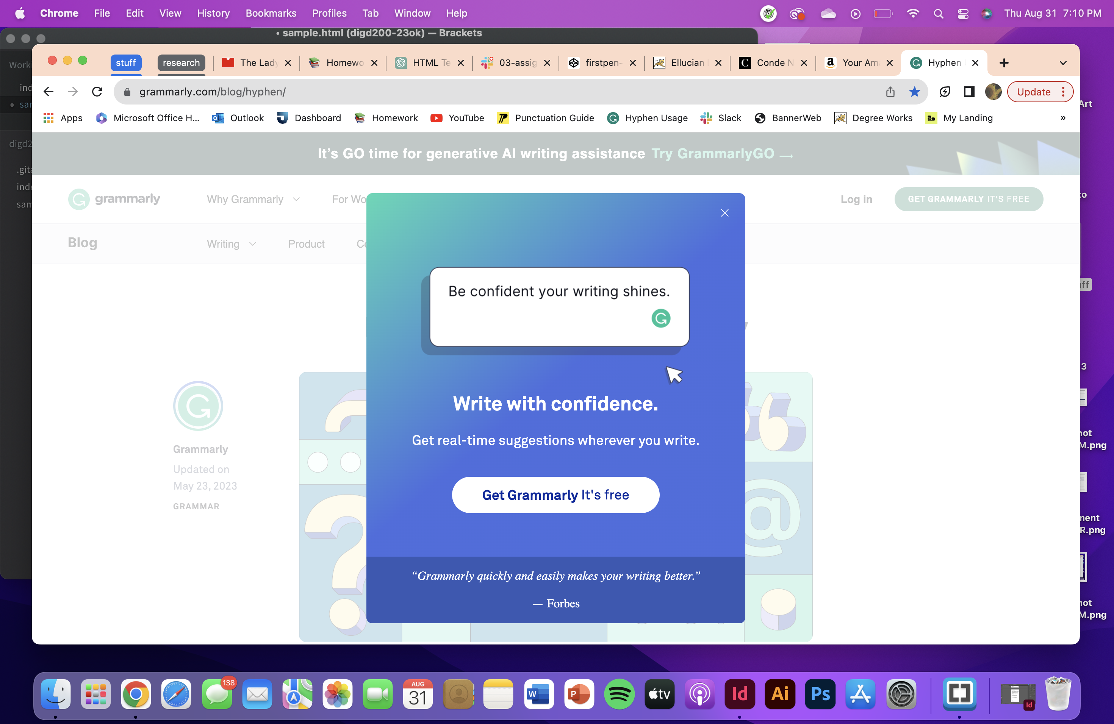
Popups
Popups appeared on the screen after first getting on the website
Covered the information I wanted to see

Slide 3
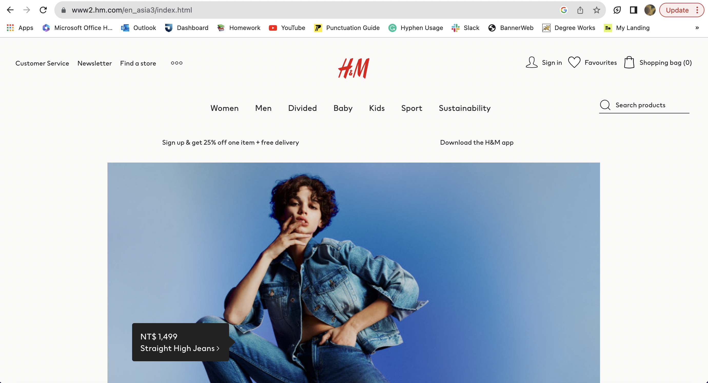
Hero Images
Picture takes up majority of the screen—had to scroll to see the entire image
Was not relevant to me

Slide 4
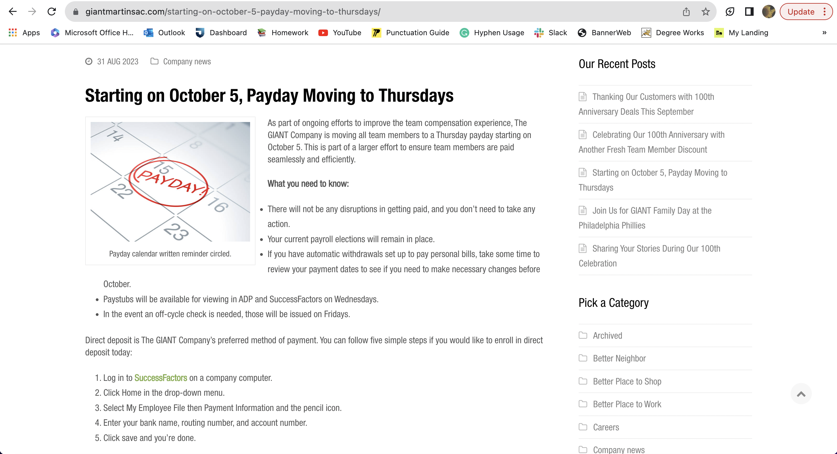
Low-contrast Text
Text to the right side is gray and small

Slide 5
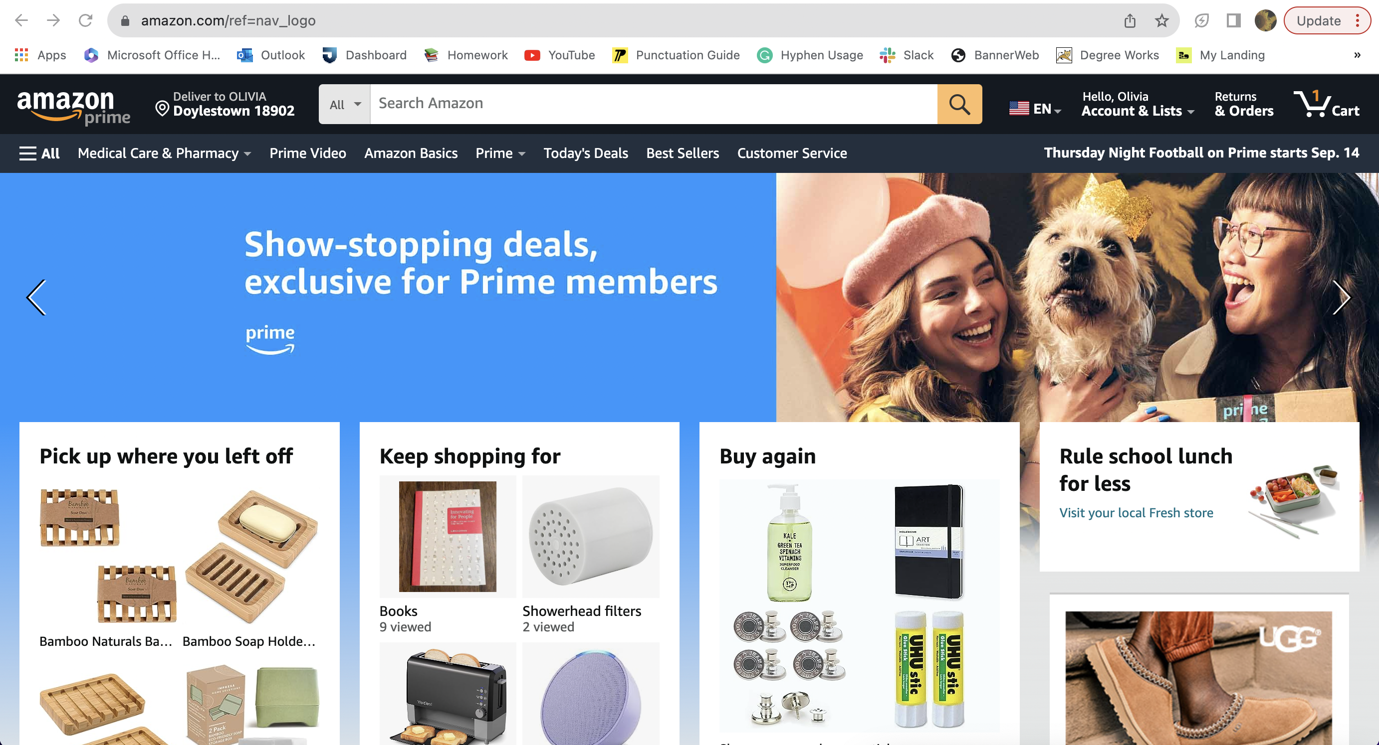
Icons Without Labels
There is no label for the button to change the language

Slide 6
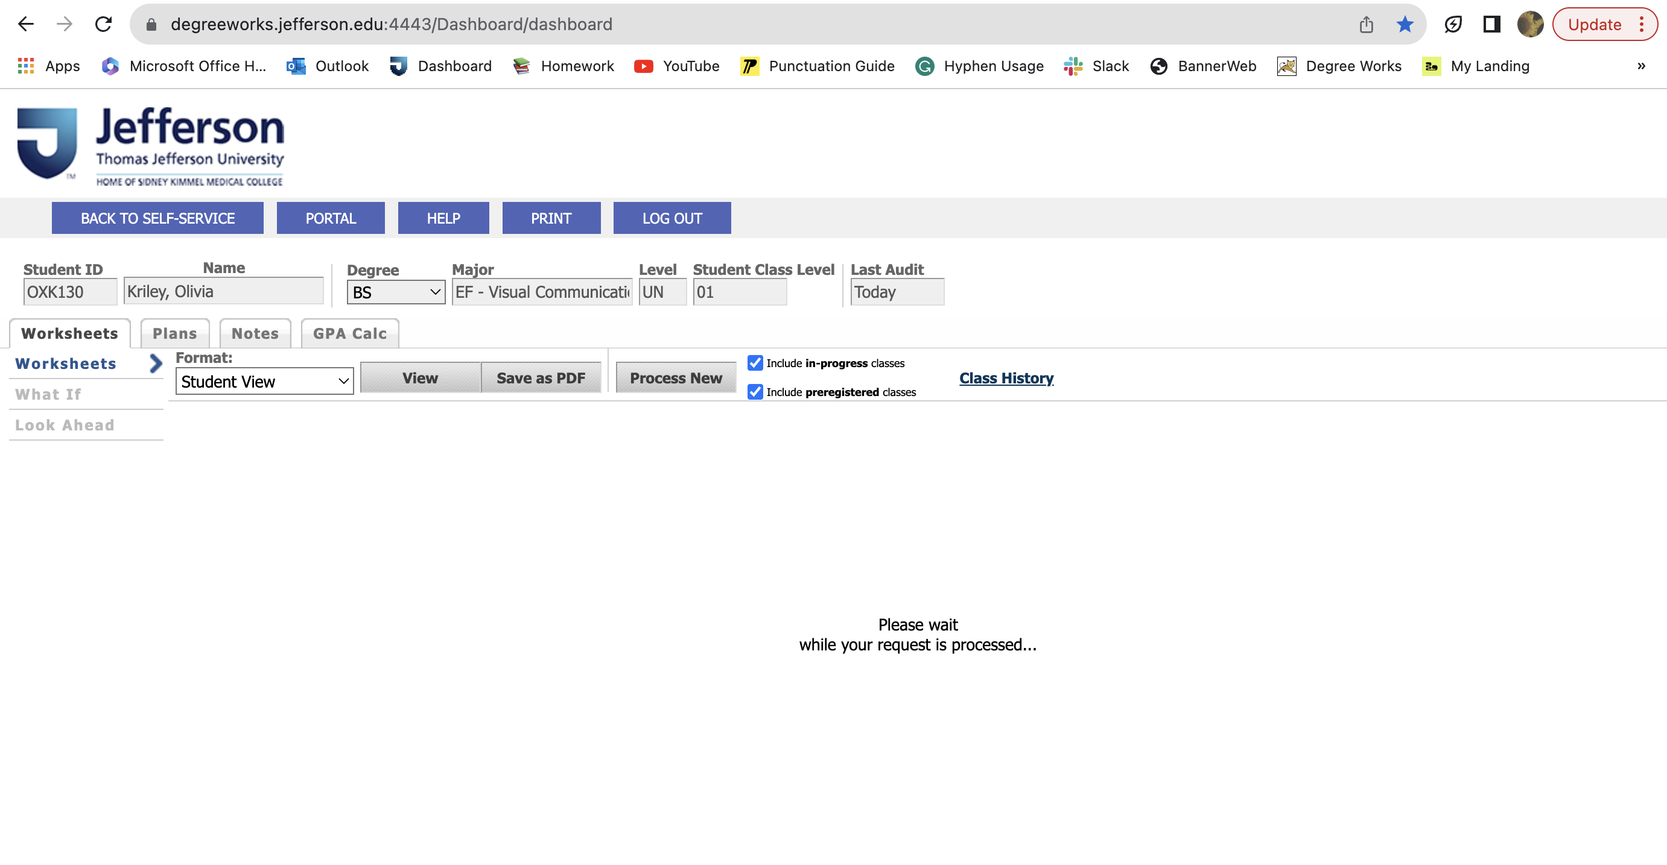
Slow Response Time
Jefferson’s DegreeWorks takes more than a couple of seconds to load
If it takes longer you have to refresh the page

